Slide 1
Shoot the Curl Marketing LLC
Capability Card Template
If this is helpful, please follow us on LinkedIn.
Shoot the Curl Marketing
For Product Marketers and Product Marketing teams to use in their day-to-day activities.

Slide 2
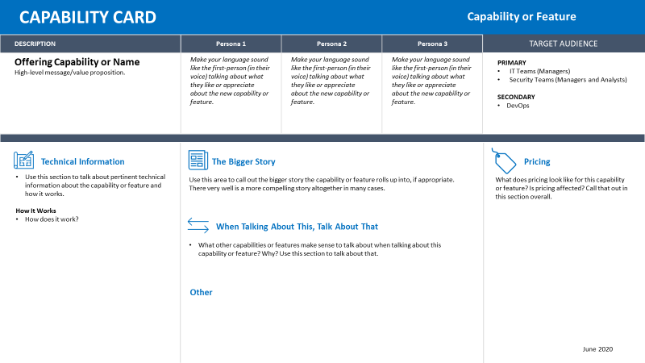
The Capability Card is really a succinct capture of pertinent information related to a new capability (as part of an existing offering) or feature as part of a launch. It’s a way to give sellers a quick-hit understanding of the new capability or feature.
Talks to what your personas would find compelling about the new capability or feature.
In most cases, the Capability Card should be just a single slide approach like this one to convey pertinent information. However, a second slide template is here in case of a string of related capabilities tied into a solution that require more consideration.
Because we’re talking about a capability or feature that is rolled up into a bigger offering, we don’t need to capture as much information as we necessarily would in a Sales Card.

Slide 3
CAPABILITY card
Capability or Feature
DESCRIPTION | Persona 1 | Persona 2 | Persona 3
Offering Capability or Name High-level message/value proposition. | Make your language sound like the first-person (in their voice) talking about what they like or appreciate about the new capability or feature. | Make your language sound like the first-person (in their voice) talking about what they like or appreciate about the new capability or feature. | Make your language sound like the first-person (in their voice) talking about what they like or appreciate about the new capability or feature.
TARGET AUDIENCE
PRIMARY
Who?
Who?
SECONDARY
Who?
Technical Information
The Bigger Story
Pricing
Use this section to talk about pertinent technical information about the capability or feature and how it works.
How It Works
How does it work?
Use this area to call out the bigger story the capability or feature rolls up into, if appropriate. There very well is a more compelling story altogether in many cases.
What does pricing look like for this capability or feature? Is pricing affected? Call that out in this section overall.
When Talking About This, Talk About That
What other capabilities or features make sense to talk about when talking about this capability or feature? Why? Use this section to talk about that.
Other
June 2020

Slide 4
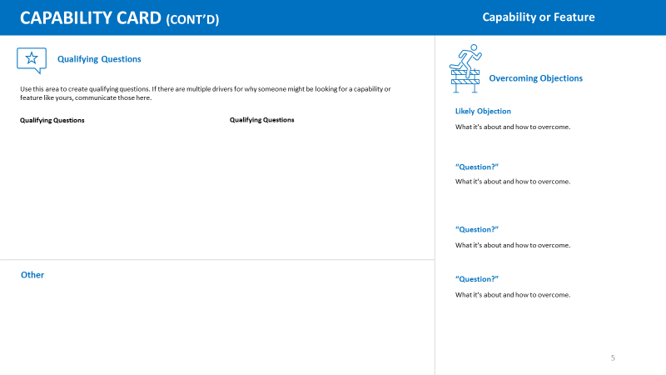
Use the second slide format below if you feel you need additional explanation as to how to sell the capability or feature. This might be used in the case of a capability that significantly changes the whole value proposition of the overall offering.
In most cases, the Capability Card should just involve the previous slide. However, a second slide template is here in case of a string of related capabilities tied into a solution that require more consideration.

Slide 5
CAPABILITY card (Cont’d)
Capability or Feature
Qualifying Questions
Overcoming Objections
Use this area to create qualifying questions. If there are multiple drivers for why someone might be looking for a capability or feature like yours, communicate those here.
Likely Objection
Qualifying Questions
Qualifying Questions
What it’s about and how to overcome.
Likely Objection
What it’s about and how to overcome.
Likely Objection
What it’s about and how to overcome.
Other
Likely Objection
What it’s about and how to overcome.

